Slide 1


Deliverables for
Esteemed Platinum Annual Sponsor
Contributing Amount- Rs. 10.00 Lacs

Slide 2



Deliverables for Platinum Annual Sponsor
Logo on all Marketing Collaterals

Slide 3
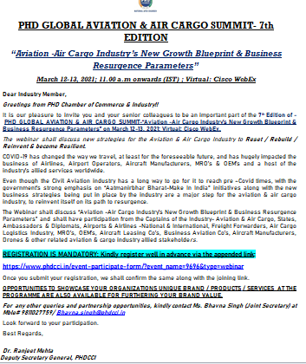

Deliverables for Platinum Annual Sponsor
Mass Mailer to the Database with Sponsor’s Logo

Slide 4


Deliverables for Platinum Annual Sponsor
Extensive Social Media Promotion

Slide 5


Deliverables for Platinum Annual Sponsor
Placement of Logos on all Paid Social Media Promotions of Specific Events Worth- INR 50,000 – 70000/-

Slide 6
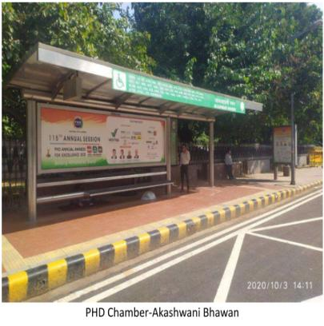
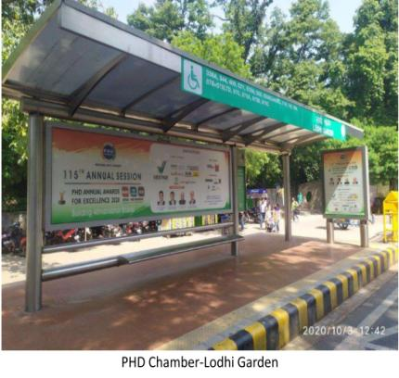
Deliverables for Platinum Annual Sponsor
Promotion of Sponsor on Hoardings, Bus Shelters & all Outdoor Promotions Worth- INR 5 – 7 lakhs

Slide 7


Deliverables for Platinum Annual Sponsor
Mention of Partner/ Sponsor in Pre-Event Press Release

Slide 8
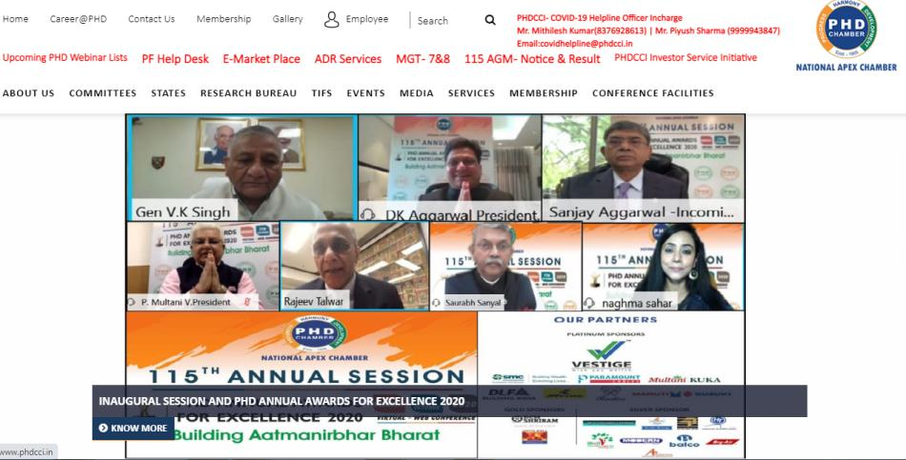
Deliverables for Platinum Annual Sponsor
Logo Placed on the Panel of Sponsors on the PHDCCI Website

Slide 9


Deliverables for Platinum Annual Sponsor
Color ads in PHD Chamber Bulletin (Monthly)
5 Full Pages Worth- 5*50,000= INR 2,50,000

Slide 10


Deliverables for Platinum Annual Sponsor
Ads in Knowledge Reports prepared by PHD Research Bureau
3 Full Page Colored Ad (First come first serve basis)
Worth- INR 1,20,000

Slide 11



Deliverables for Platinum Annual Sponsor
Ads in MCM Directory & all other PHDCCI Promotional Production like Calendar, Diary etc.
1 Full Page Colored Ad, Worth- INR 1,00,000 for Color Ad

Slide 12

Deliverables for Platinum Annual Sponsor
1 Full Page Colored Ad (Centre Page) in PHD Annual Report
Worth- INR 1,00,000

Slide 13
Deliverables for Platinum Annual Sponsor
Promoting Partner Testimonial on Post-Event Press Release

Slide 14


Deliverables for Platinum Annual Sponsor
Prominent Placement of Company Logo in Half/Full Page Event Print Ad (Worth- INR 1,00,000 – 2,00,000)

Slide 15
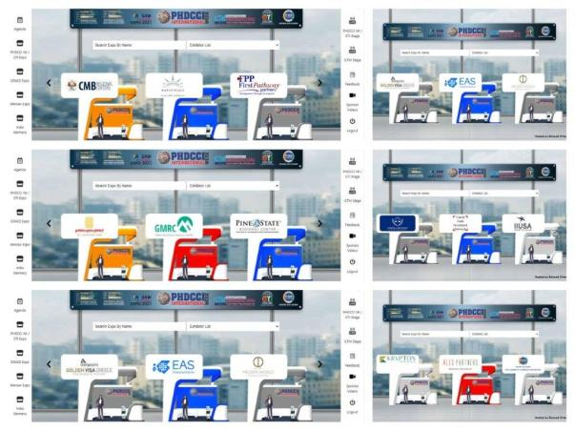
Deliverables for Platinum Annual Sponsor
Free 20 Exhibitor Stall in Virtual Exhibitions which will be organized by PHDCCI (Worth Rs. 4,00,000/-)

Slide 16




Deliverables for Platinum Annual Sponsor
Placement of Company’s Logo in the Picture Frame shared in Media along with Press Release

Slide 17



Deliverables for Platinum Annual Sponsor
Company Logo in the AGM & Flagship Event Invitation Cards

Slide 18


Deliverables for Platinum Annual Sponsor
Preferred Sponsor logo visibility in Events & Event Highlight Telecasted on Premium Business Electronic Channels (Worth- INR 8,00,000)
Our sponsors got visibility in the starting, middle and ending of the event showcase which was aired on ET Now that witnessed a viewership of more than thousand viewers Pan-India.

Slide 19


Deliverables for Platinum Annual Sponsor
Sponsor Logo prominently displayed on Virtual Backdrops & other Presentations

Slide 20

Deliverables for DIAMOND Annual Sponsor
Live Ticker on PHD Chamber of Commerce and Industry’s website

Slide 21
Deliverables for Platinum Annual Sponsor
Additional attractive benefits offered
3 Full Days complimentary Booking in Shriram, Modi Hall for AGM/Event/Meeting in a year
(Worth- INR 1,02,000)
3 Full Days Complimentary Bookings in PHDCCI LPS Auditorium for Holding Company AGMs
(Worth- INR 2,55,000 )
7 Free Library Membership (@Rs 15000/ per member)
(Worth- INR 1,50,000)
5 Speaker slot in Parliamentarian Sessions & Chamber’s Flagship Events in a year
(Worth- 5*1,00,000=5,00,000)
Preference will be given & maximum representations drafted by the sponsors to be placed with the Government (concerning his/her company/industry)
15 Free Virtual Exhibition Registration for International & Domestic Exhibitions for 1 Year (Rs. 1,500 per visitor participant)
(Worth- INR 22500/-)
Advertisement Astons in All Webinars of PHDCCI
Link- https://drive.google.com/file/d/1U9eq8UVzhVEahX0lG0LBey3tY_7eERtB/view?usp=sharing
8 Complimentary entry of participants in 3 paid programs of PHD Chamber
(Worth- INR 16,000/-)

Slide 22
Deliverables for Platinum Annual Sponsor
Total Yearly Worth for Membership- INR 29,00,000/- (approx)

