Slide 1


Deliverables for
Esteemed Silver Annual Sponsor
Contributing Amount- Rs. 2.50 Lacs

Slide 2



Deliverables for Silver Annual Sponsor
Logo on all Marketing Collaterals

Slide 3


Deliverables for Silver Annual Sponsor
Placement of Logos on all Paid Social Media Promotions of Specific Events Worth- INR 50,000 – 70000/-

Slide 4
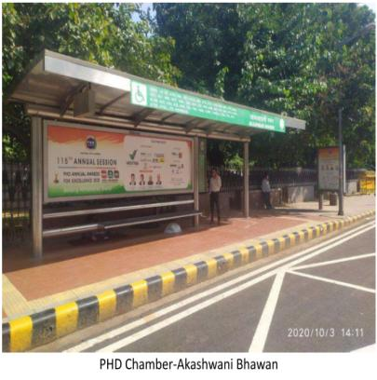
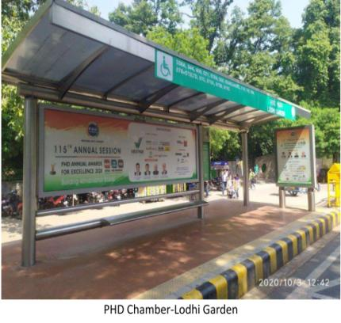
Deliverables for Silver Annual Sponsor
Promotion of Sponsor on Hoardings, Bus Shelters & all Outdoor Promotions Worth- INR 5 – 7 lakhs

Slide 5
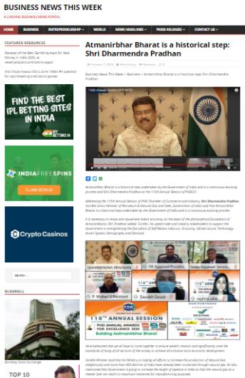

Deliverables for Silver Annual Sponsor
Mention of Partner/ Sponsor in Pre-Event Press Release

Slide 6
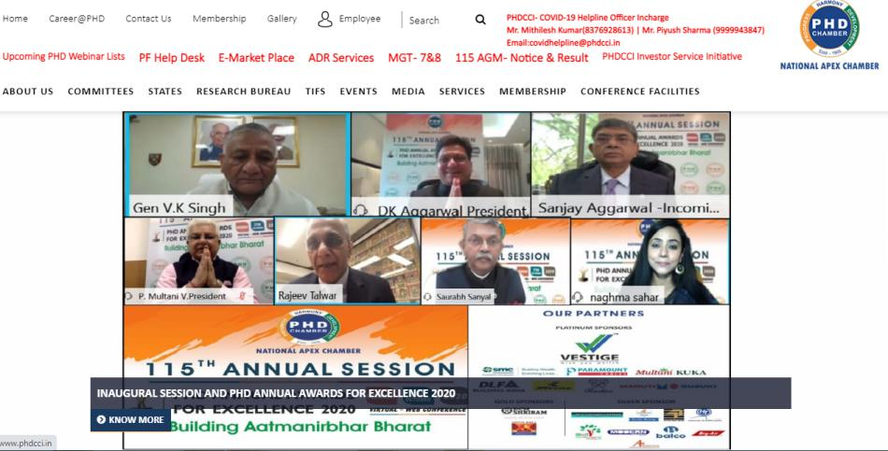
Deliverables for Silver Annual Sponsor
Logo Placed on the Panel of Sponsors on the PHDCCI Website

Slide 7


Deliverables for Silver Annual Sponsor
Color ads in PHD Chamber Bulletin (Monthly)
2 Full Pages Worth- 2*50,000= INR 1,00,000

Slide 8


Deliverables for Silver Annual Sponsor
Ads in Knowledge Reports prepared by PHD Research Bureau
1 Full Page Colored Ad (First come first serve basis)
Worth- INR 40,000

Slide 9


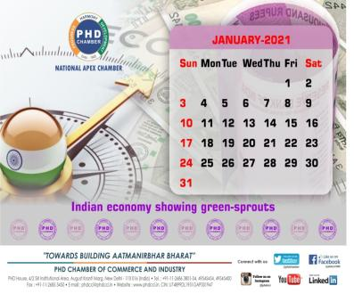
Deliverables for Silver Annual Sponsor
Ads in MCM Directory & all other PHDCCI Promotional Production like Calendar, Diary etc.
Half Page Black and White Ad, Worth- INR 25,000

Slide 10
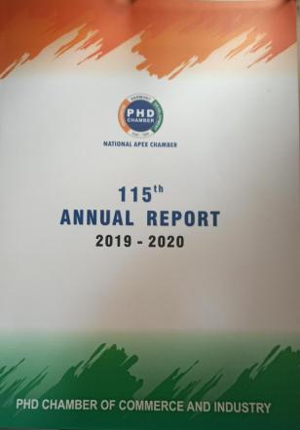
Deliverables for Silver Annual Sponsor
1 Full Black and While Ad (Centre Page) in PHD Annual Report
Worth- INR 50,000

Slide 11
Deliverables for Silver Annual Sponsor
Promoting Partner Testimonial on Post-Event Press Release

Slide 12


Deliverables for Silver Annual Sponsor
Prominent Placement of Company Logo in Half/Full Page Event Print Ad (Worth- INR 1,00,000 – 2,00,000)

Slide 13
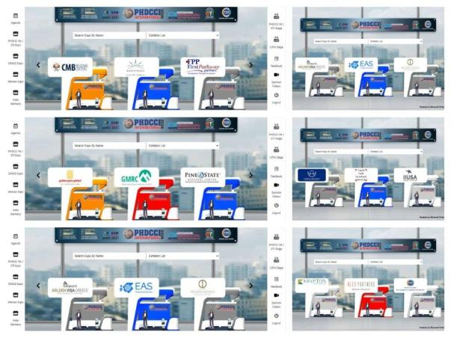
Deliverables for Silver Annual Sponsor
Free 5 Exhibitor Stall in Virtual Exhibitions which will be organized by PHDCCI (Worth Rs. 4,00,000/-)

Slide 14

Deliverables for Silver Annual Sponsor
Sponsor Logo prominently displayed on Virtual Backdrops & other Presentations

Slide 15




Deliverables for Silver Annual Sponsor
Placement of Company’s Logo in the Picture Frame shared in Media along with Press Release

Slide 16



Deliverables for Silver Annual Sponsor
Company Logo in the AGM & Flagship Event Invitation Cards

Slide 17

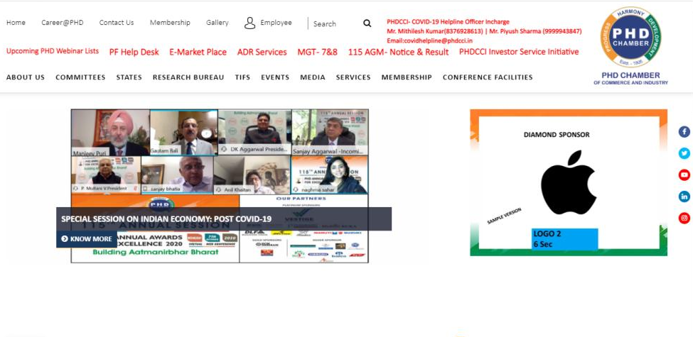
Deliverables for DIAMOND Annual Sponsor
Live Ticker on PHD Chamber of Commerce and Industry’s website

Slide 18
Deliverables for Silver Annual Sponsor
Additional attractive benefits offered
1 Day complimentary Booking in Shriram, Modi Hall for AGM/Event/Meeting in a year
(Worth- INR 34,000)
2 Half Days Complimentary Bookings in PHDCCI LPS Auditorium for Holding Company AGMs
(Worth- INR 1,22,000)
3 Free Library Membership (@Rs 15000/ per member)
(Worth- INR 45,000)
Preference will be given & maximum representations drafted by the sponsors to be placed with the Government (concerning his/her company/industry)
5 Free Virtual Exhibition Registration for International & Domestic Exhibitions for 1 Year (Rs. 1,500 per visitor participant)
(Worth- INR 75,000/-)
Advertisement Astons in All Webinars of PHDCCI
Link- https://drive.google.com/file/d/1U9eq8UVzhVEahX0lG0LBey3tY_7eERtB/view?usp=sharing
3 Complimentary entry of participants in 3 paid programs of PHD Chamber
(Worth- INR 6,000/-)

Slide 19
Deliverables for Silver Annual Sponsor
Total Yearly Worth for Membership- INR 14,00,000/-(approx)

