Slide 1


Deliverables for
Esteemed Diamond Annual Sponsor
Contributing Amount- Rs. 15.00 Lacs

Slide 2


Deliverables for DIAMOND Annual Sponsor
Logo on all Marketing Collaterals

Slide 3
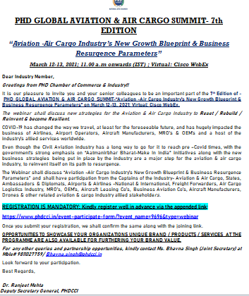

Deliverables for DIAMOND Annual Sponsor
Mass Mailer to the Database with Sponsor’s Logo

Slide 4


Deliverables for DIAMOND Annual Sponsor
Extensive Social Media Promotion

Slide 5


Deliverables for DIAMOND Annual Sponsor
Specific Social Media Story, under the created sponsor frame, to be run on all Social Media handles

Slide 6


Deliverables for DIAMOND Annual Sponsor
Placement of Logos on all Paid Social Media Promotions of Specific Events Worth- INR 50,000 – 70000/-

Slide 7
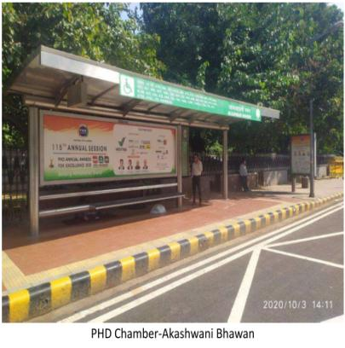
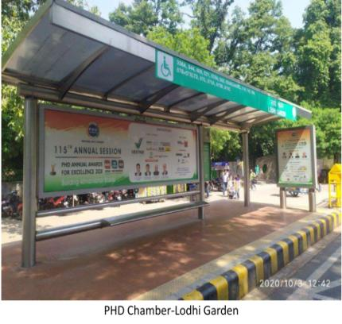
Deliverables for DIAMOND Annual Sponsor
Promotion of Sponsor on Hoardings, Bus Shelters & all Outdoor Promotions Worth- INR 5 – 7 lakhs

Slide 8
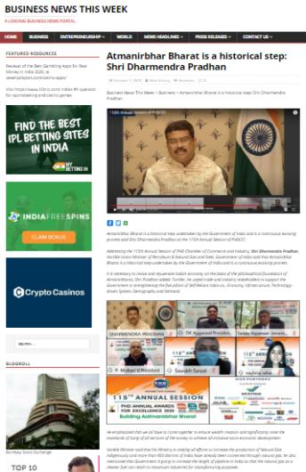

Deliverables for DIAMOND Annual Sponsor
Mention of Partner/ Sponsor in Pre-Event Press Release

Slide 9
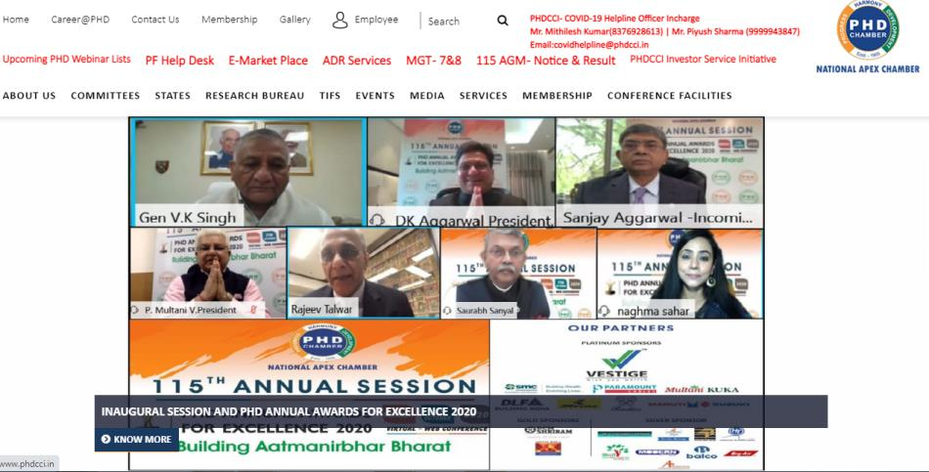
Deliverables for DIAMOND Annual Sponsor
Logo Placed on the Panel of Sponsors on the PHDCCI Website

Slide 10


Deliverables for DIAMOND Annual Sponsor
Color ads in PHD Chamber Bulletin (Monthly)
12 Full Pages Worth- 12*50,000= INR 6,00,000

Slide 11


Deliverables for DIAMOND Annual Sponsor
Ads in Knowledge Reports prepared by PHD Research Bureau
5 Full Page Colored Ad (First come first serve basis)
Worth- INR 2,00,000

Slide 12


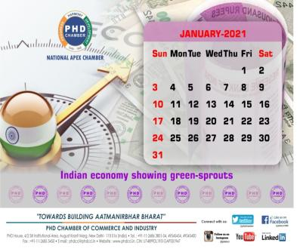
Deliverables for DIAMOND Annual Sponsor
Ads in MCM Directory & all other PHDCCI Promotional Production like Calendar, Diary etc.
1 Full Page Colored Ad, Worth- INR 1,00,000 for Color Ad

Slide 13
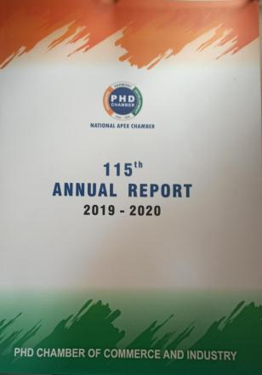
Deliverables for DIAMOND Annual Sponsor
2 Full Page Colored Ad (Centre Page) in PHD Annual Report
Worth- INR 2,50,000
Disclaimer- Dummy sample, as there has been no ad published in the last 10 annual reports

Slide 14
Deliverables for DIAMOND Annual Sponsor
Promoting Partner Testimonial on Post-Event Press Release

Slide 15


Deliverables for DIAMOND Annual Sponsor
Prominent Placement of Company Logo in Half/Full Page Event Print Ad (Worth- INR 1,00,000 – 2,00,000)

Slide 16

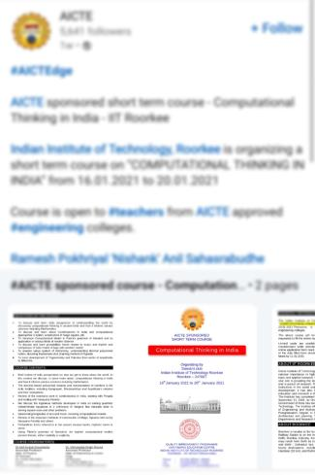
Deliverables for DIAMOND Annual Sponsor
Brief Introduction (1-2 page) of Sponsor about their Organization, for uploading on LinkedIn with PHD Event Banner

Slide 17


Deliverables for DIAMOND Annual Sponsor
Shoot-out Video of the Company’s Representative to be uploaded on all Social Media Handles during Event Promotions

Slide 18
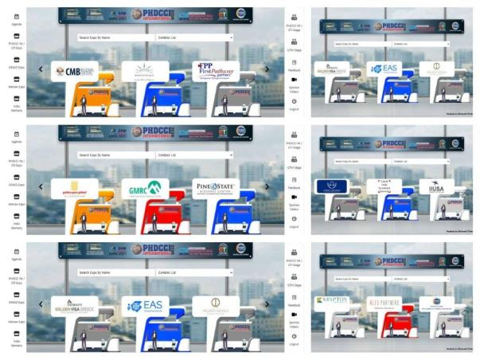
Deliverables for DIAMOND Annual Sponsor
Free 30 Exhibitor Stall in Virtual Exhibitions which will be organized by PHDCCI (Worth Rs. 6,00,000/-)

Slide 19

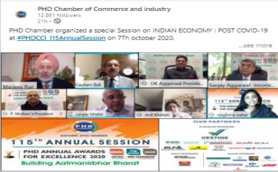


Deliverables for DIAMOND Annual Sponsor
Placement of Company’s Logo in the Picture Frame shared in Media along with Press Release

Slide 20



Deliverables for DIAMOND Annual Sponsor
Company Logo in the AGM & Flagship Event Invitation Cards

Slide 21


Deliverables for DIAMOND Annual Sponsor
Preferred Sponsor logo visibility in Events & Event Highlight Telecasted on Premium Business Electronic Channels (Worth- INR 8,00,000)
Our sponsors got visibility in the starting, middle and ending of the event showcase which was aired on ET Now that witnessed a viewership of more than thousand viewers Pan-India.

Slide 22

Deliverables for DIAMOND Annual Sponsor
Sponsor Logo prominently displayed on Virtual Backdrops & other Presentations

Slide 23
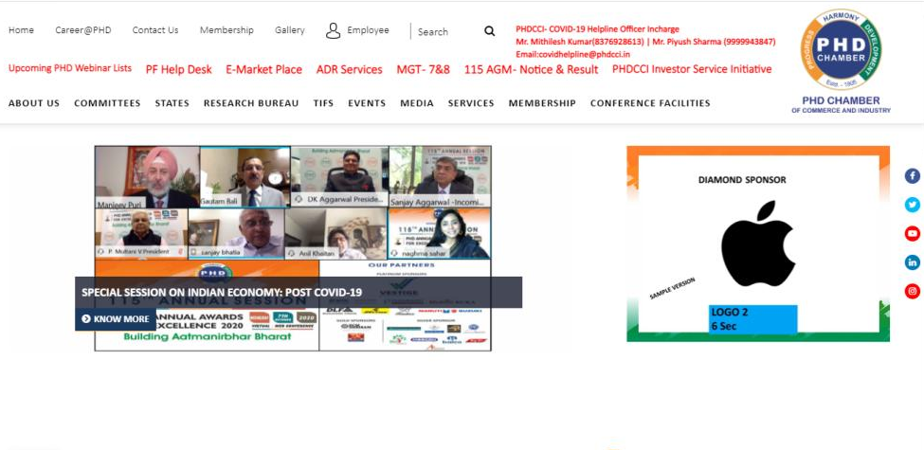
Deliverables for DIAMOND Annual Sponsor
Live Ticker on PHD Chamber of Commerce and Industry’s website

Slide 24
Deliverables for DIAMOND Annual Sponsor
Additional Attractive Benefits Offered
6 Full Days complimentary Booking in Shriram, Modi Hall for AGM/Event/Meeting in a year
Worth- INR 1,35,000
6 Full Days Complimentary Bookings in PHDCCI LPS Auditorium for Holding Company AGMs
Worth- 6*85,500=INR 5,13,000
6 Full Days complimentary Booking in Shriram, Modi Hall for AGM/Event/Meeting in a year
Worth- INR 1,35,000
10 Free Library Membership (@Rs 15000/ per member)
Worth- INR INR1,50,000
8 Speaker slot in Parliamentarian Sessions & Chamber’s Flagship Events in a year
Worth- 8*1,00,000=8,00,000
Preference will be given & maximum representations drafted by the sponsors to be placed with the Government (concerning his/her company/industry)
20 Free Virtual Exhibition Registration for International & Domestic Exhibitions for 1 Year (Rs. 1,500 per visitor participant)
Worth- INR 30,000
The Senior Representative of the Partnering Company will accompany the delegation while presenting the Representation to the Government (with bouquet and memento)
Reception of Chief Guest/ Minister for events at PHD House
Advertisement Astons in All Webinars of PHDCCI
Link- https://drive.google.com/file/d/1U9eq8UVzhVEahX0lG0LBey3tY_7eERtB/view?usp=sharing
10 Complimentary entry of participants in 3 paid programs of PHD Chamber
Worth- INR 20,000/-

Slide 25
Deliverables for DIAMOND Annual Sponsor
Total Yearly Worth for Membership- INR 51,00,000/- (approx)

